Slide 1
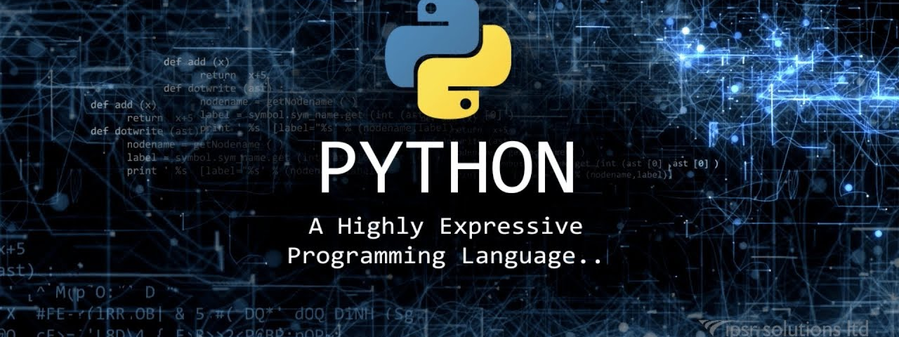




Computational Thinking with Python
Fall 2019
@cse_bennett
@csebennett

Slide 2
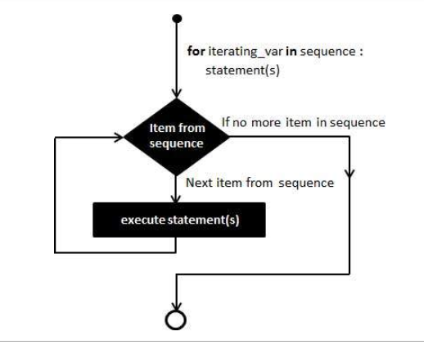
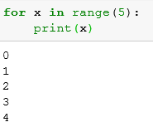
For Loop (definite loop)
Loop to read sequence
A for loop is used for iterating over a sequence (that is either a list, a tuple, a dictionary, a set, or a string). Can execute a set of statements, once for each item in a list, tuple, set etc.
Example:
Syntax:
for iterating_var in sequence:
statements(s)

Slide 3
Loop continues until we reach the last item in the sequence. The body of for loop is separated from the rest of the code using indentation.
Syntax of for Loop
for val in sequence:
loop body
Here, val is the variable that takes the value of the item inside the sequence on each iteration.

Slide 4
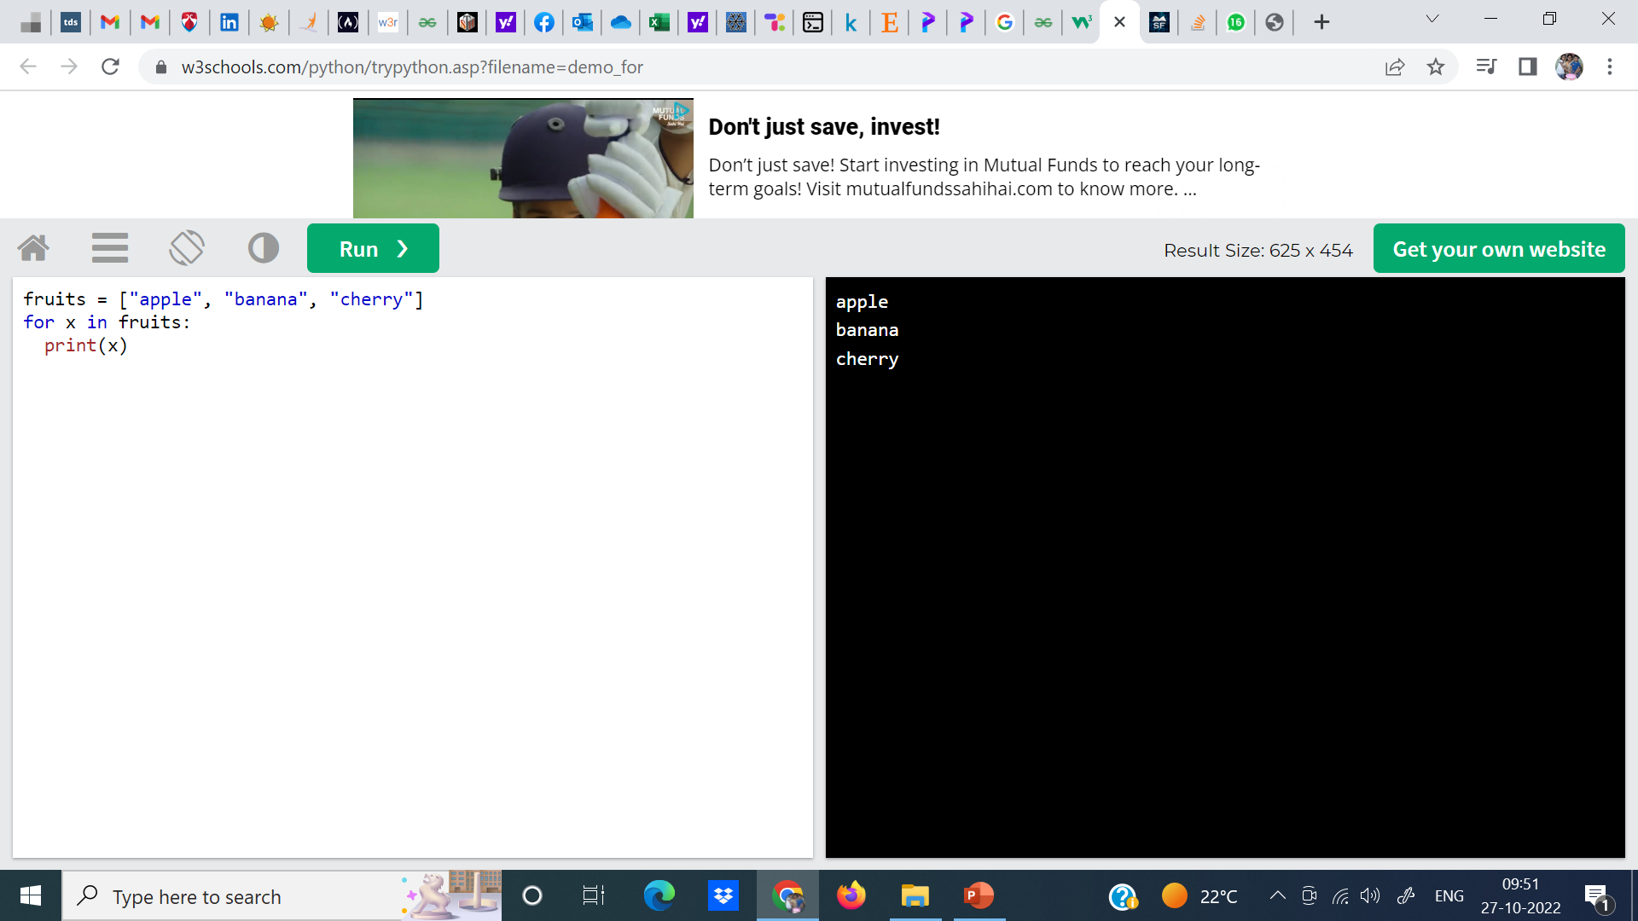
With the for loop we can execute a set of statements, once for each item in a list, tuple, set etc.

Slide 5
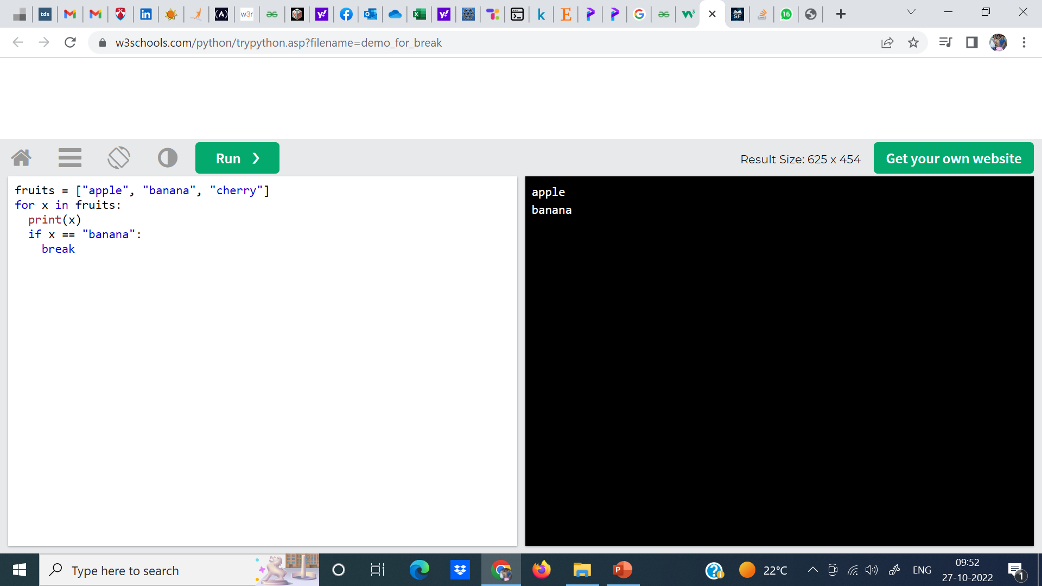

Slide 6
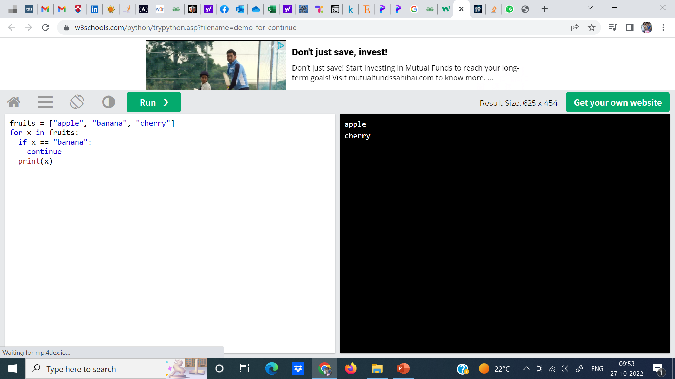

Slide 7
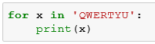
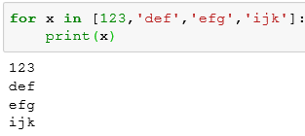
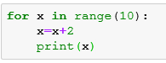
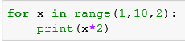
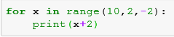
For Loop: What will be the output?
1.
2.
3.
4.
5.

Slide 8
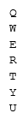
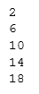
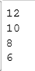
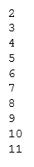
For Loop: Answers to Previous Questions
1 2 3 4 5

Slide 9
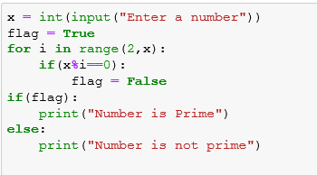
Exercise: Write a program to find whether a given number is prime or not
Solution:

Slide 10
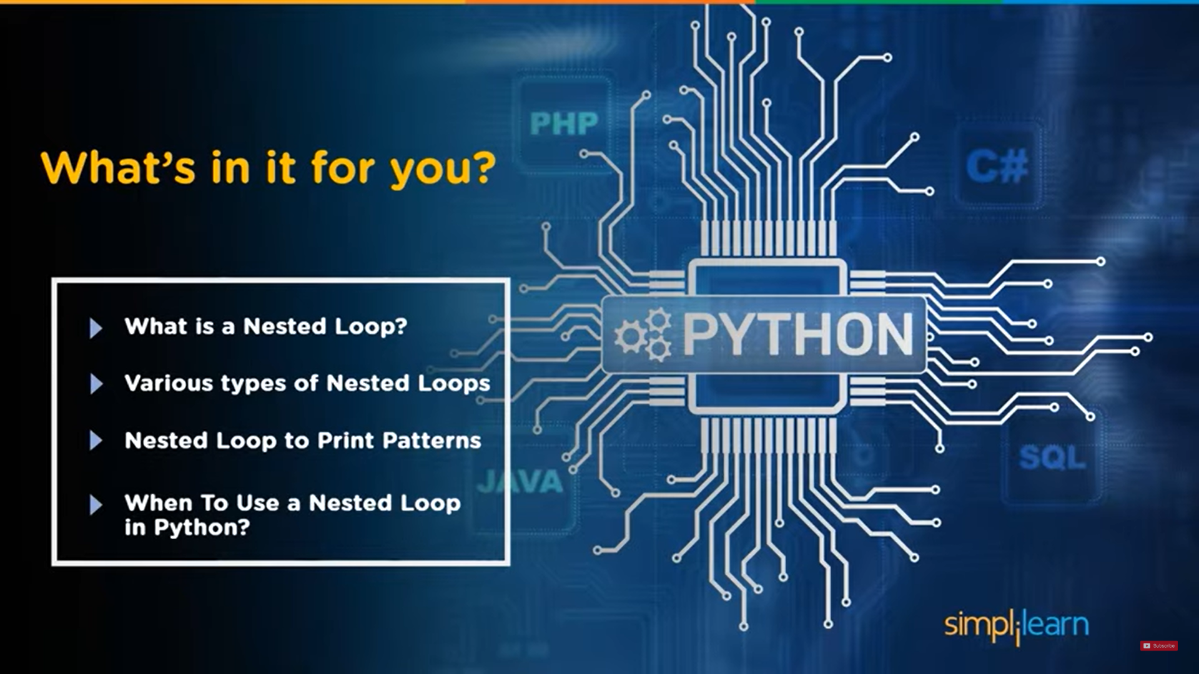

Slide 11
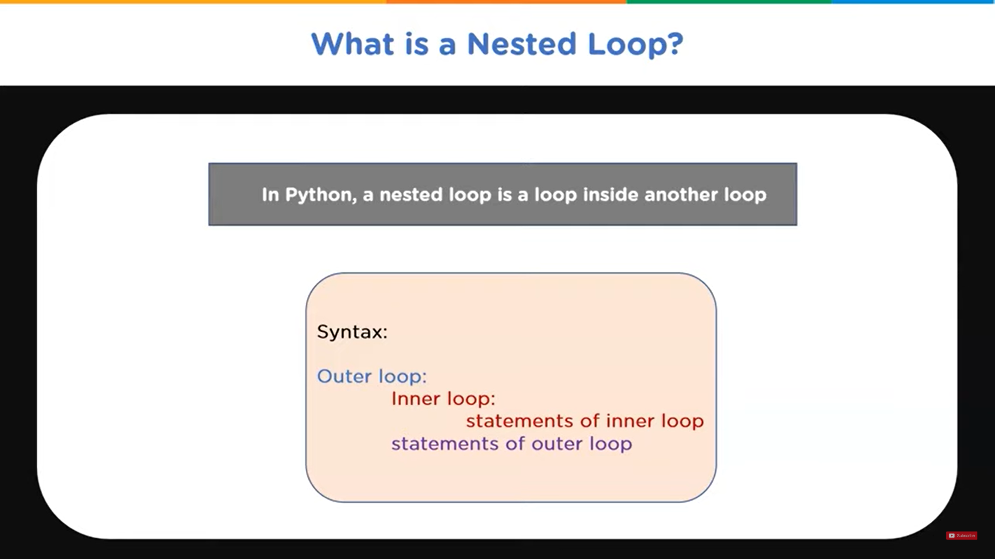

Slide 12
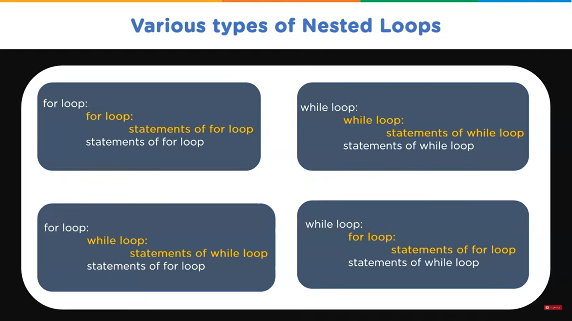

Slide 13
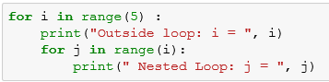
Nested Loop
Loop inside a loop a is called nested loop.
Example:

Slide 14
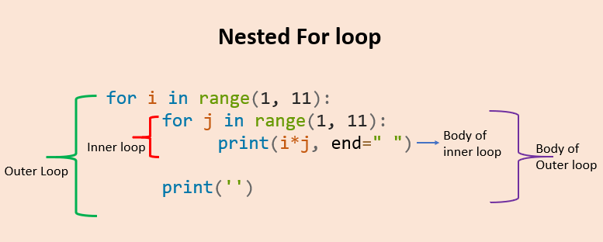

Slide 15
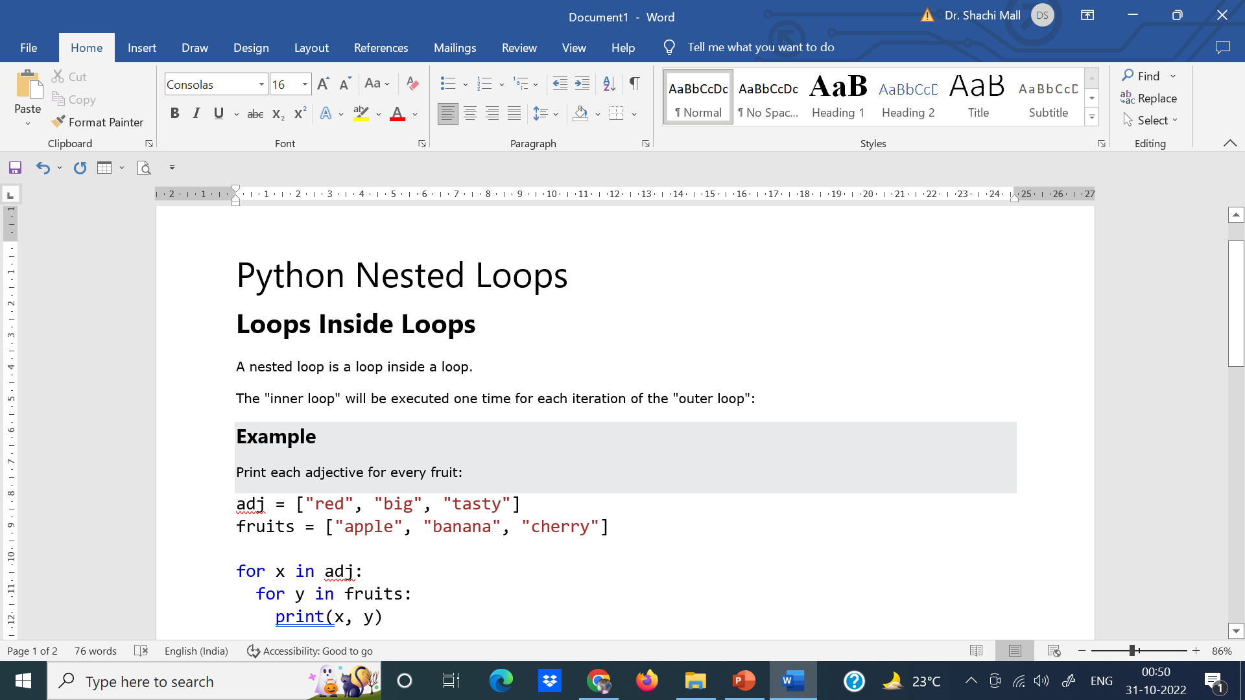
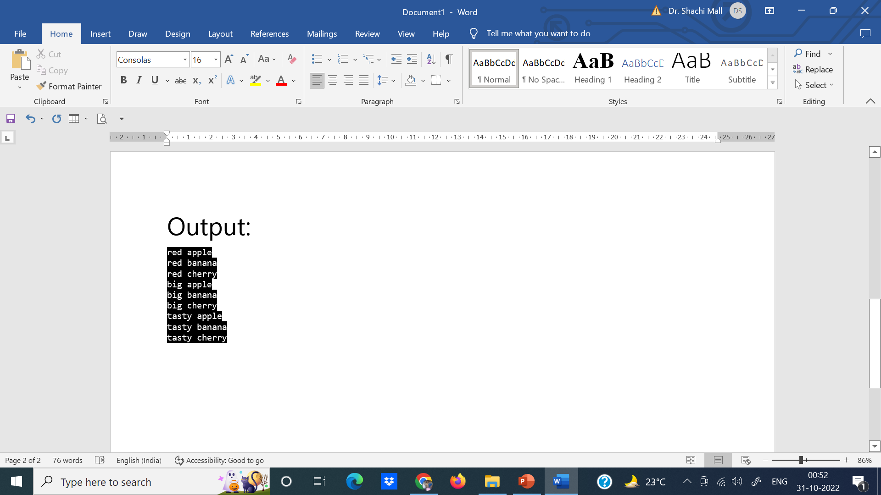

Slide 16
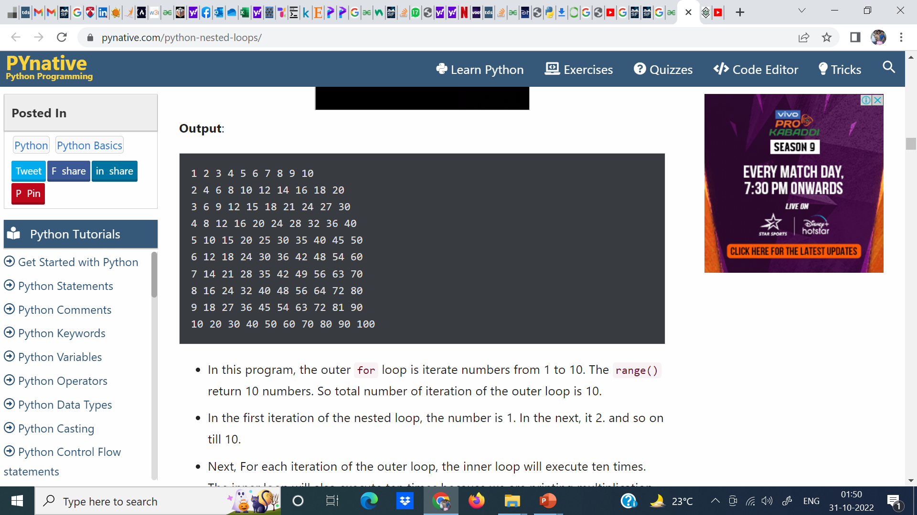
Example: Write a nested for loop program to print multiplication table in Python
# outer loop iterate from 1 to 10
for i in range(1, 11):
# nested loop / inner loop
# to iterate from 1 to 10
for j in range(1, 11):
# print multiplication
print(i * j, end=' ')
print()

Slide 17
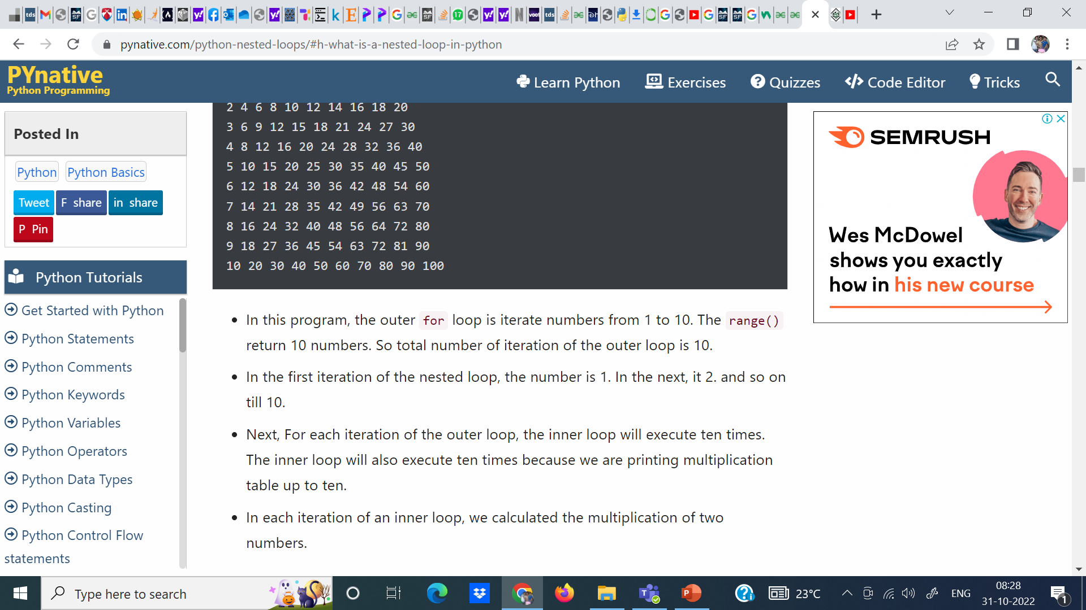

Slide 18
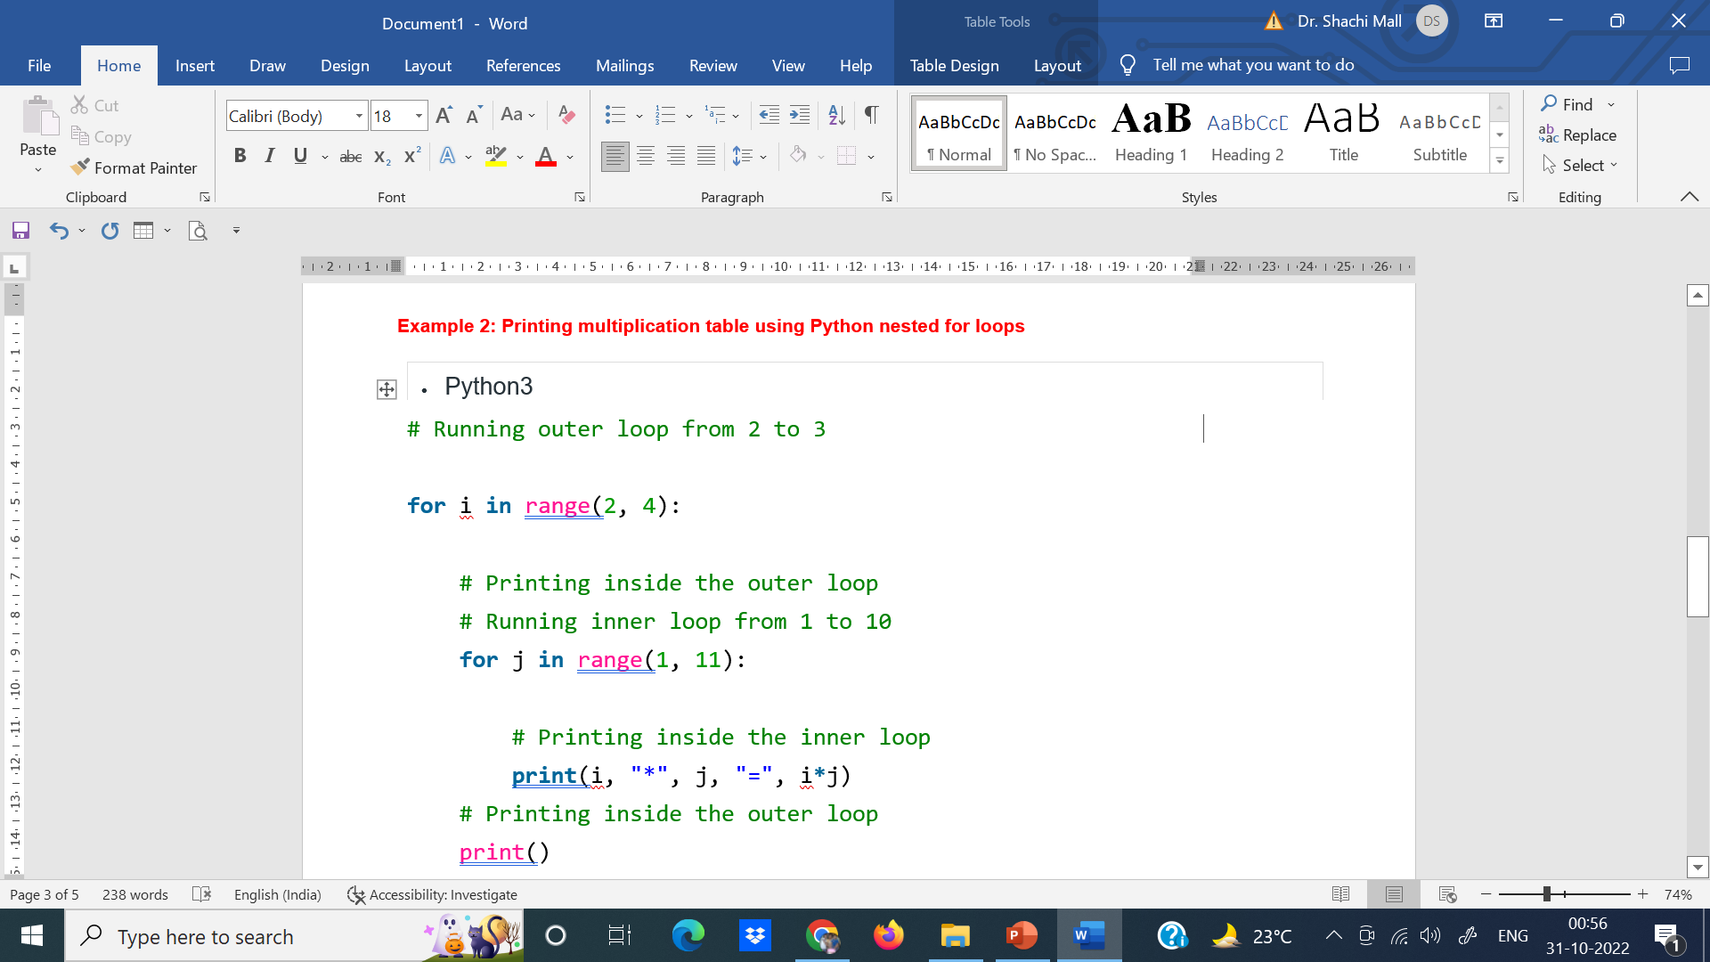
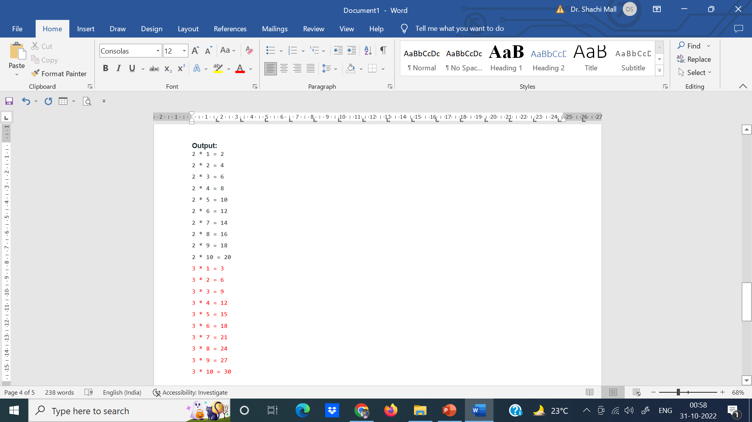

Slide 19
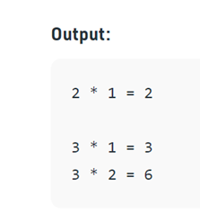
Using break statement in nested loops
It is a type of loop control statement. In a loop, we can use the break statement to exit from the loop. When we use a break statement in a loop it skips the rest of the iteration and terminates the loop. let’s understand it using an example.
Code:
# Running outer loop from 2 to 3
for i in range(2, 4):
# Printing inside the outer loop
# Running inner loop from 1 to 10
for j in range(1, 11):
if i==j:
break
# Printing inside the inner loop
print(i, "*", j, "=", i*j)
# Printing inside the outer loop
print()

Slide 20
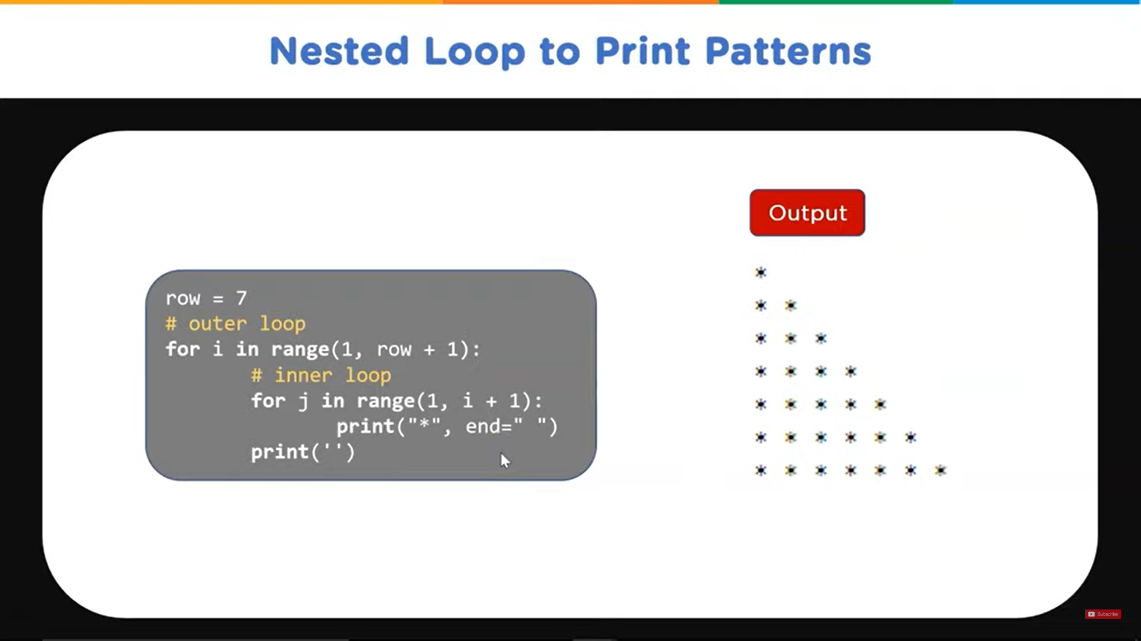

Slide 21
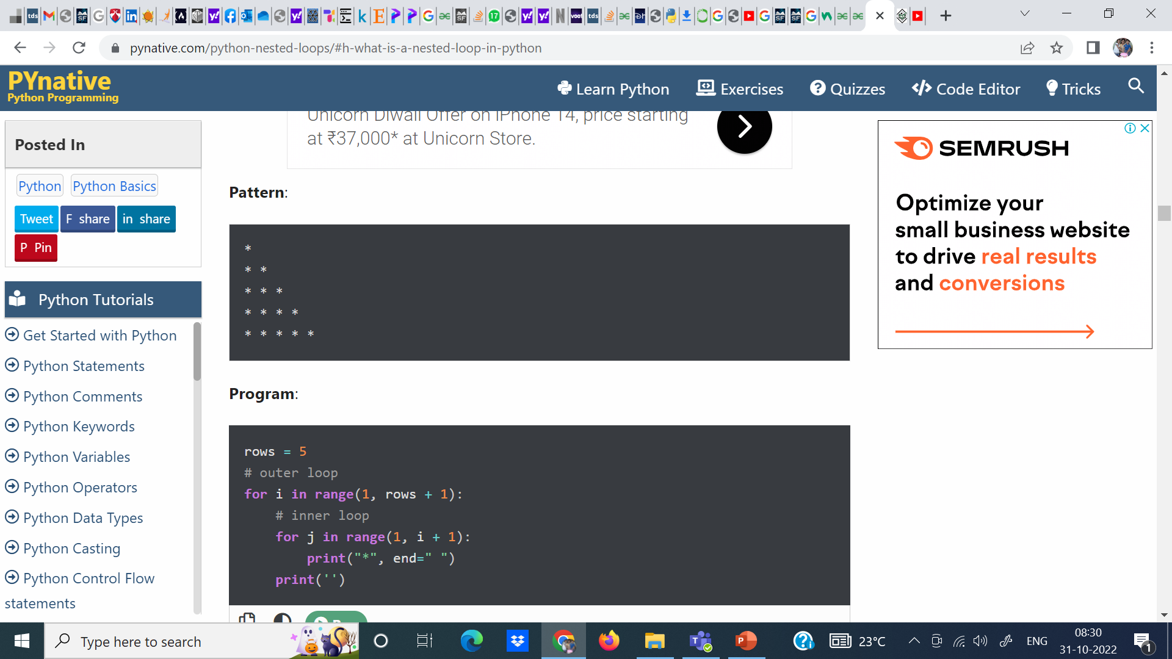

Slide 22
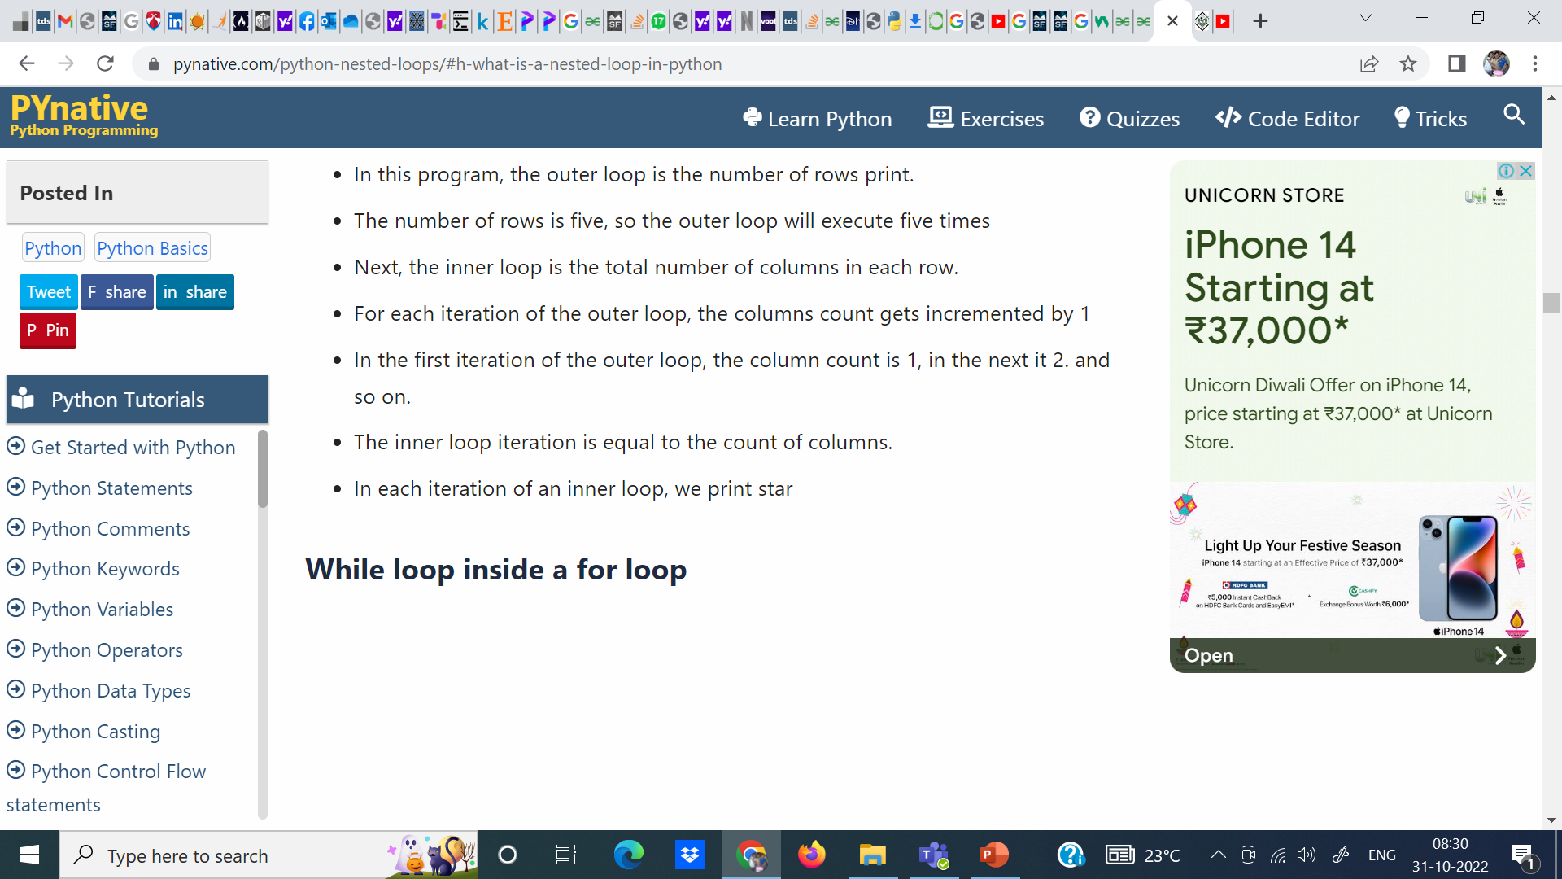

Slide 23
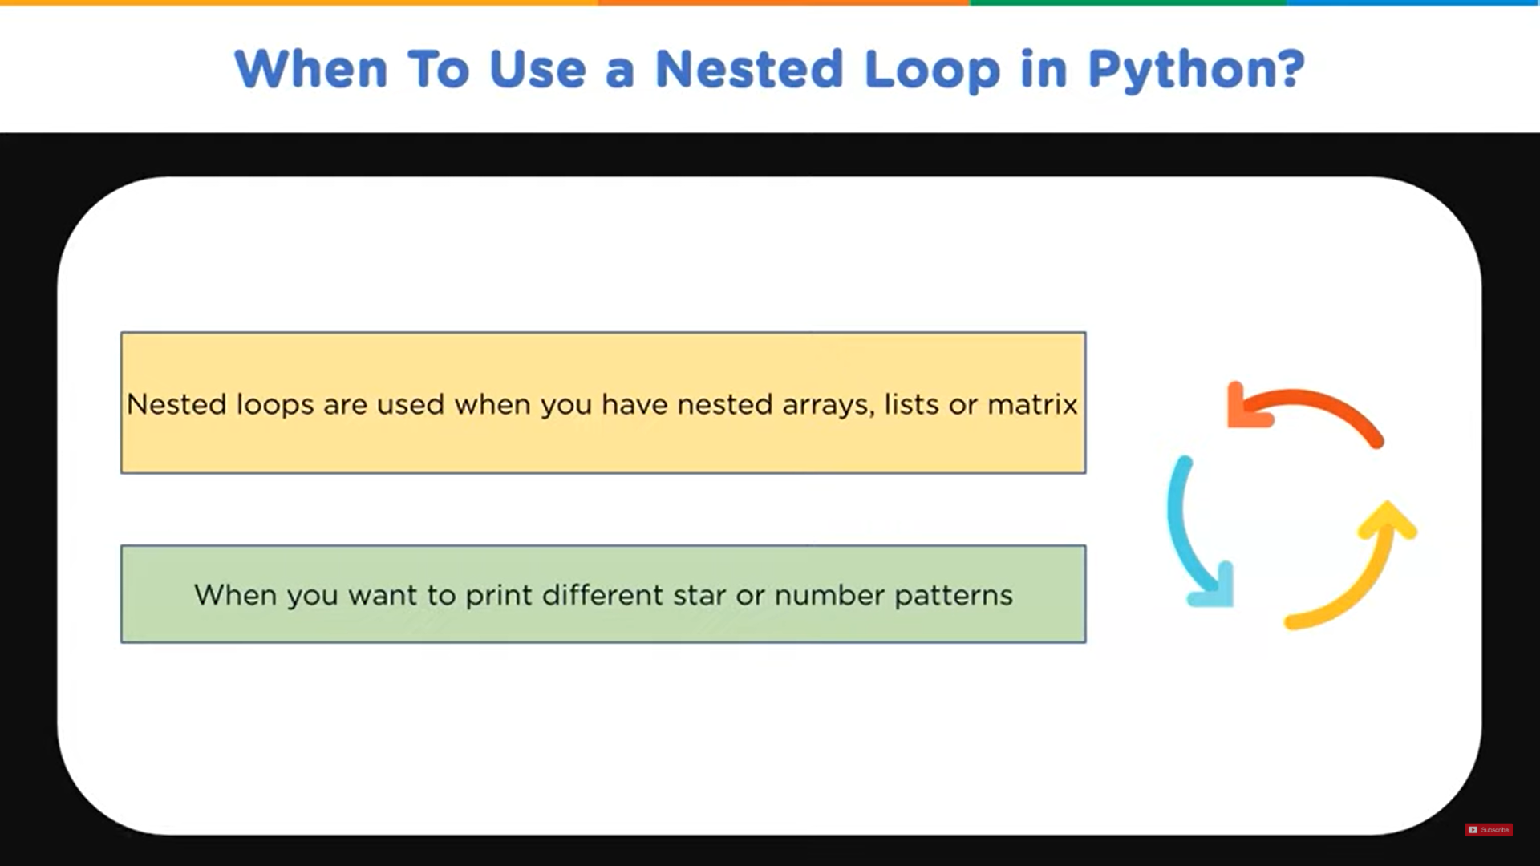

Slide 25
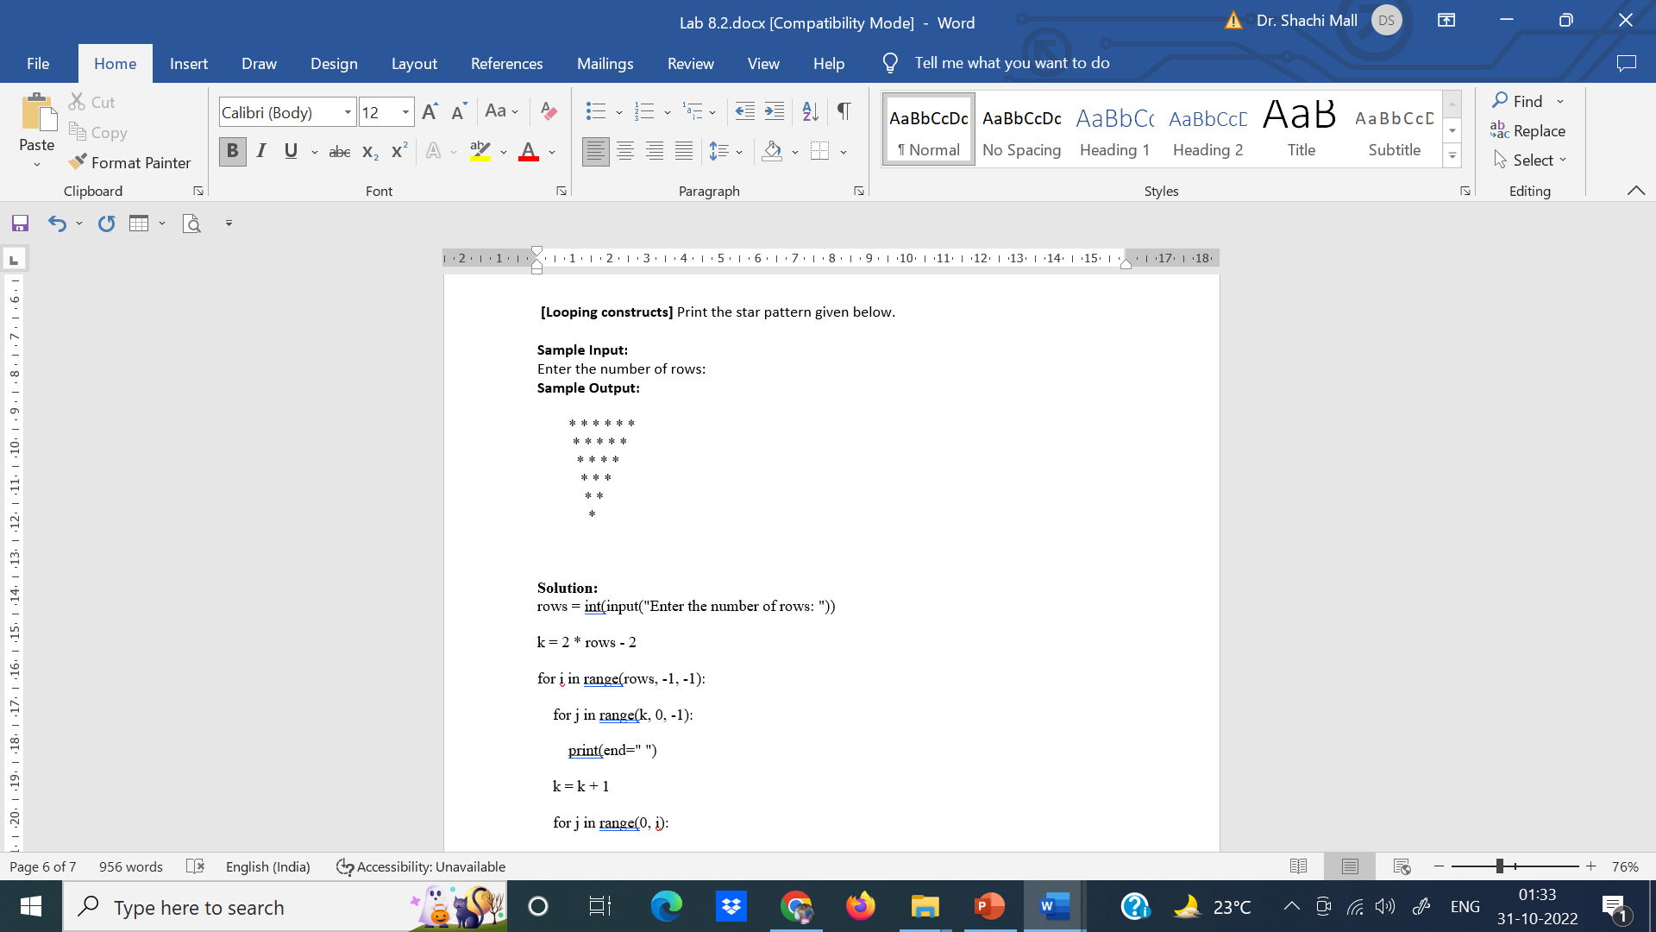

Slide 26
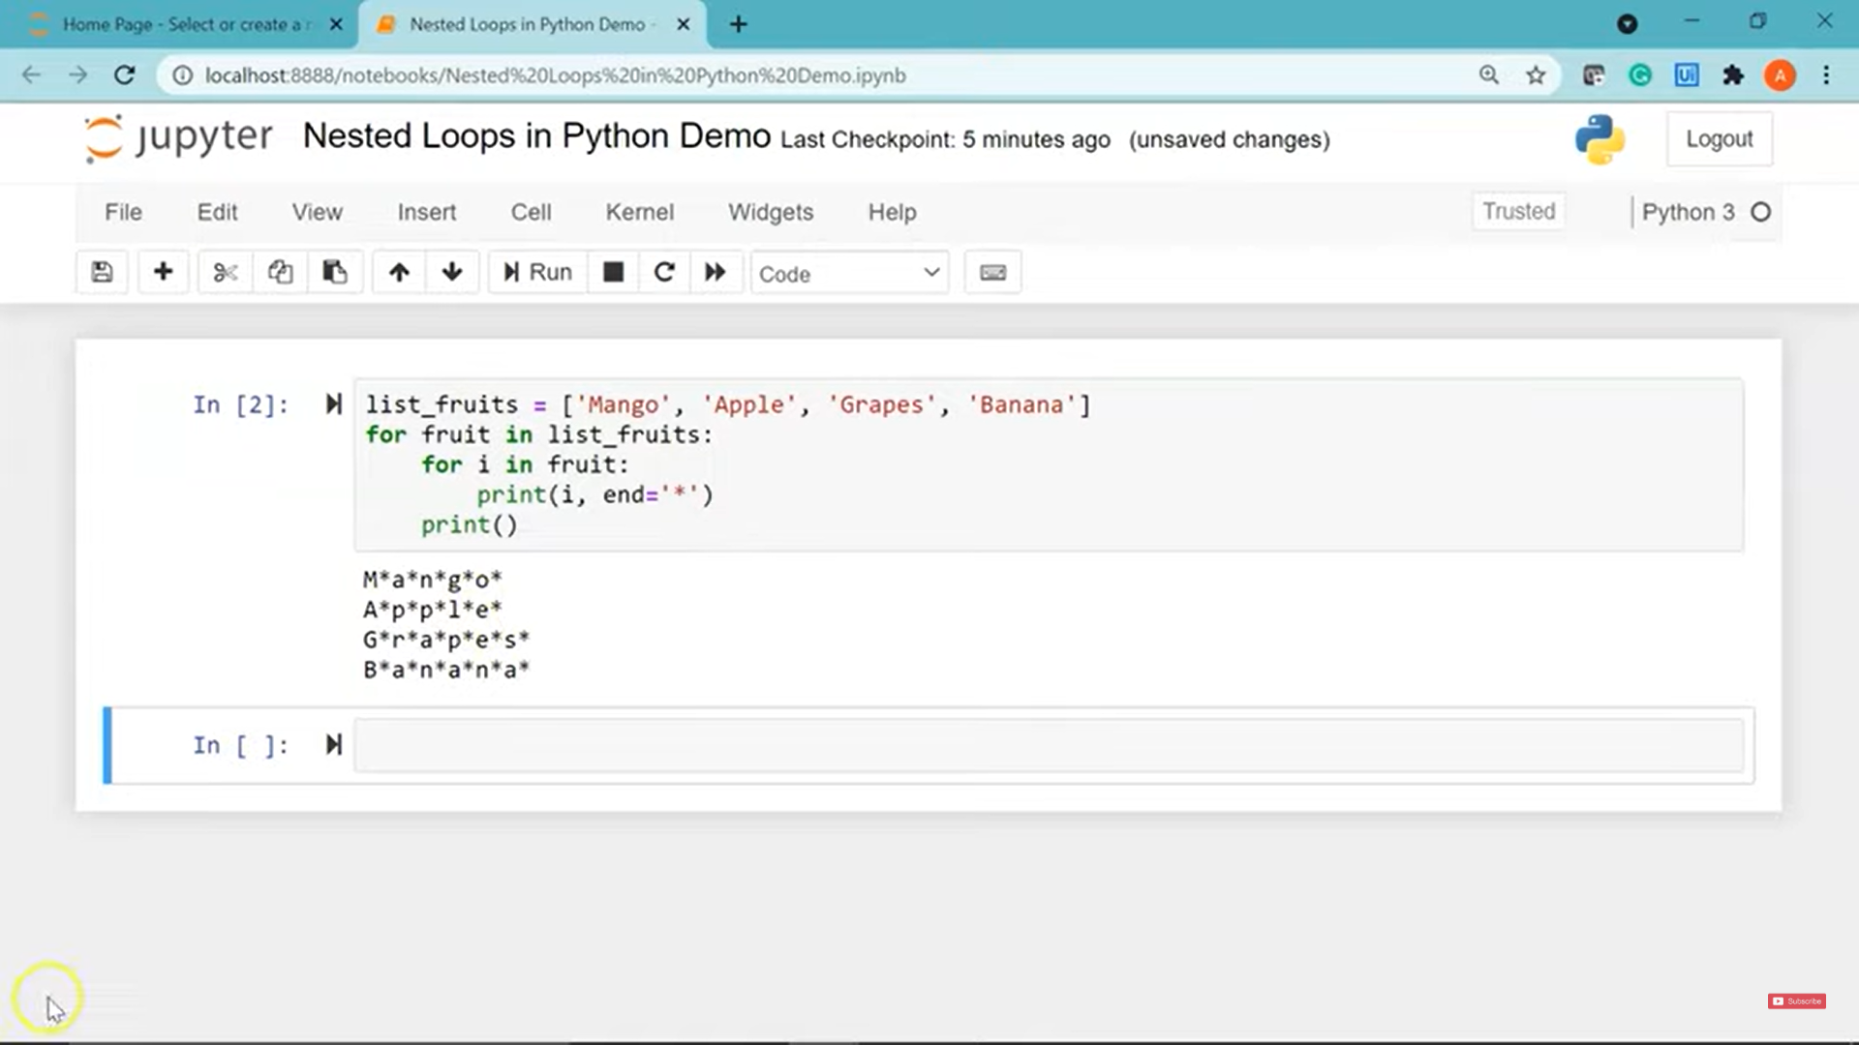

Slide 27
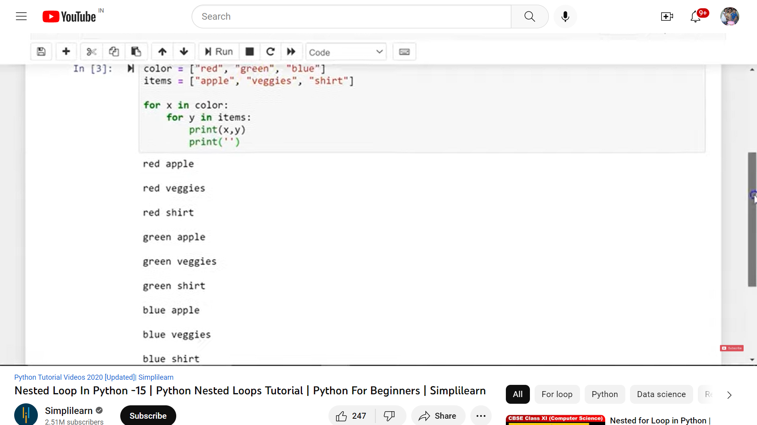

Slide 28
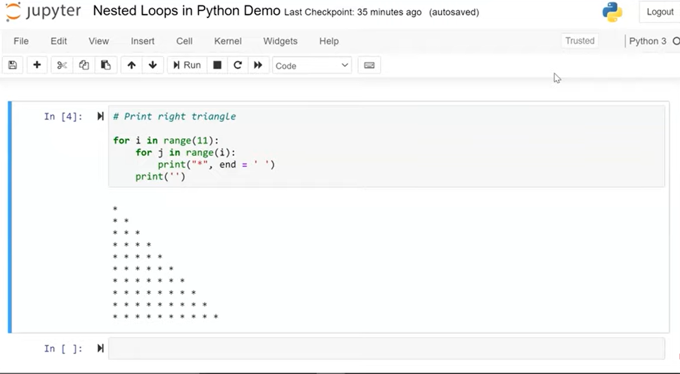

Slide 29
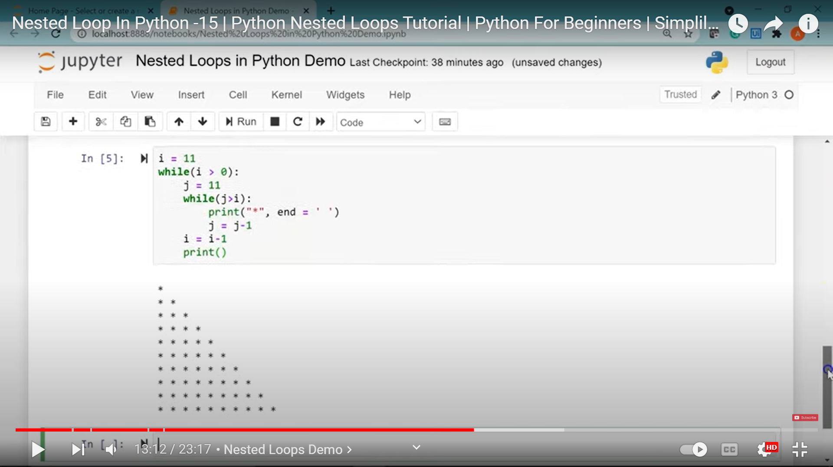

Slide 30
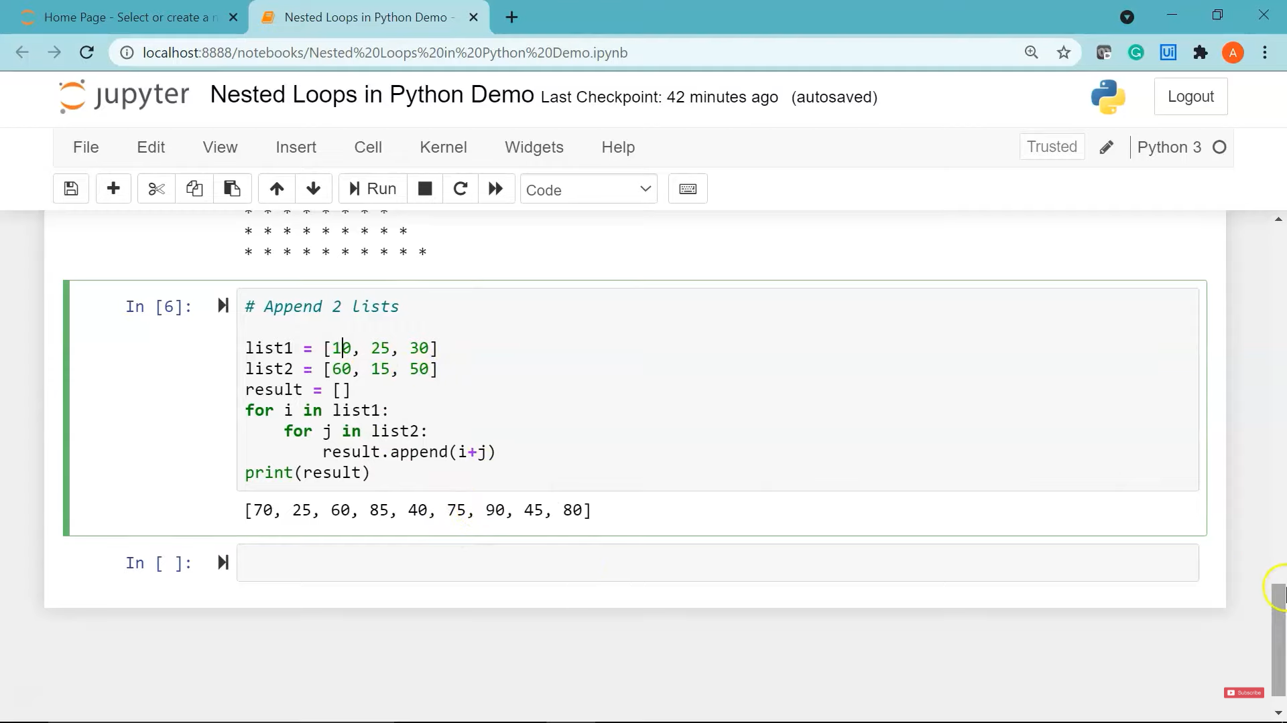

Slide 31
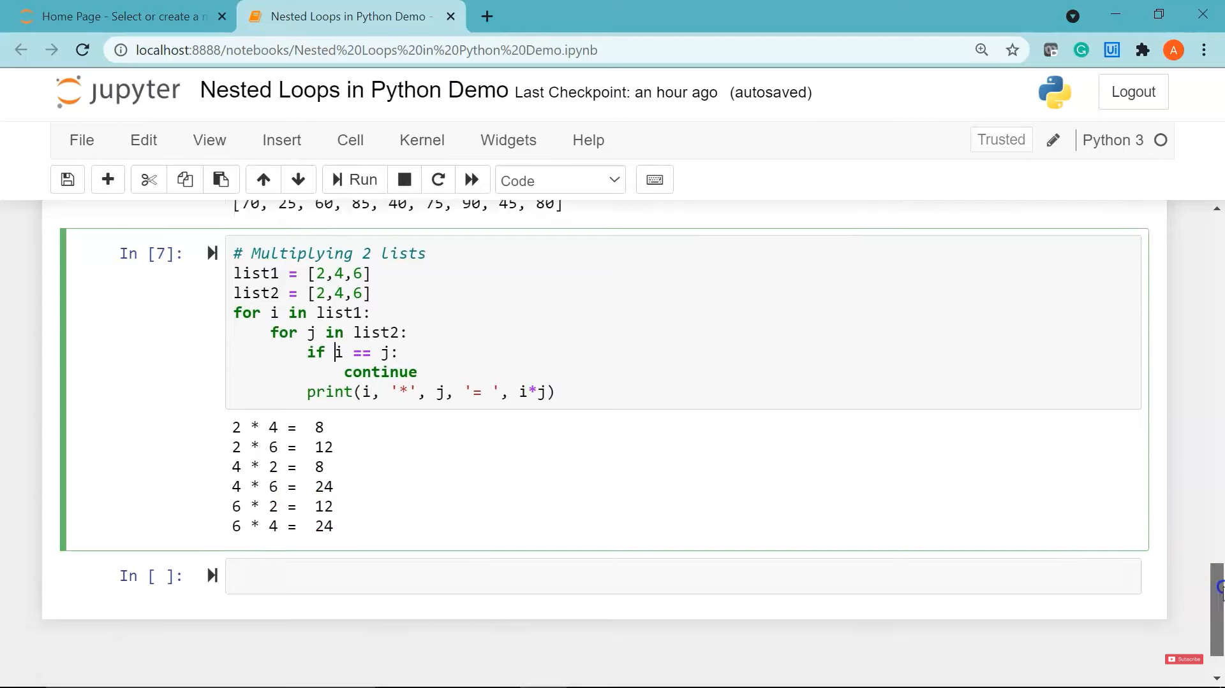

Slide 32
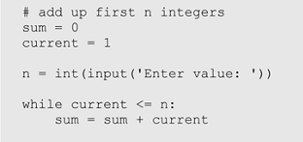
Infinite loop
An infinite loop is an iterative control structure that never terminates (or eventually terminates with a system error).
Infinite loops are generally the result of programming errors.
For example: if the condition of a while loop can never be false, an infinite loop will result when executed.

Slide 33
Loop Control Statements
Break Statement: Terminates the loop statement and transfers execution to the statement immediately following the loop.
Continue Statement: Causes the loop to skip the remainder of its body and immediately retest its condition prior to reiterating.
Pass Statement:The pass statement in Python is used when a statement is required syntactically but you do not want any command or code to execute.
Example:
for letter in 'Python’:
if letter == 'h’:
pass
print('This is pass block’)
print('Current Letter :', letter)
print(“Loop Ended!“)
Output:
Current Letter : P
Current Letter : y
Current Letter : t
This is pass block
Current Letter : h
Current Letter : o
Current Letter : n
Loop Ended
Use of pass in if:
a = 33 b = 200 if b > a: pass

Slide 34
Break and Continue: Examples
Break Statement:
Continue Statement:
Ex.1: fruits = ["apple", "banana", "cherry"] for x in fruits: print(x) if x == "banana": break
Ex.2: fruits = ["apple", "banana", "cherry"] for x in fruits: if x == "banana": break print(x)
Output:
apple banana
fruits = ["apple", "banana", "cherry"] for x in fruits: if x == "banana": continue print(x)
Output:
apple cherry

Slide 35
MCQs
A while loop continues to iterate until its condition becomes false.
TRUE
FALSE
A while loop executes zero or more times.
TRUE
FALSE
All iteration can be achieved by a while loop.
TRUE
FALSE
An infinite loop is an iterative control structures that,
Loops forever and must be forced to terminate
Loops until the program terminates with a system error
Both of the above
The terms definite loop and indefinite loop are used to indicate whether,
A given loop executes at least once
The number of times that a loop is executed can be determined before the loop is executed.
Both of the above
A Boolean flag is,
A variable
Has the value True or False
Is used as a condition for control statements
All of the above

Slide 36
MCQs: Answers
A while loop continues to iterate until its condition becomes false.
TRUE
FALSE
A while loop executes zero or more times.
TRUE
FALSE
All iteration can be achieved by a while loop.
TRUE
FALSE
An infinite loop is an iterative control structures that,
Loops forever and must be forced to terminate
Loops until the program terminates with a system error
Both of the above
The terms definite loop and indefinite loop are used to indicate whether,
A given loop executes at least once
The number of times that a loop is executed can be determined before the loop is executed.
Both of the above
A Boolean flag is,
A variable
Has the value True or False
Is used as a condition for control statements
All of the above

